Slide 1


Extensions to IES, Mappings and Use Cases
Ian Bailey, CTO @ Telicent
March 2021

Slide 2
Stage 1 – Track Data
We have built a simple track provider that accumulates AIS data until it hits a user-defined threshold of data points per vessel then it pushes out an IES message containing the track information for that vessel onto the Kafka log. Users can set the throughput rate and track size as environment variables that are provided to the container (Docker).
Data is in n-triples format, zipped before being put onto Kafka. At the request of Canada, heading, course and vessel / activity type data has not been mapped (they plan to calculate it).
The slides that follow show the necessary additions to IES that were needed (LocationObservation and LocationTransponder)

Slide 3
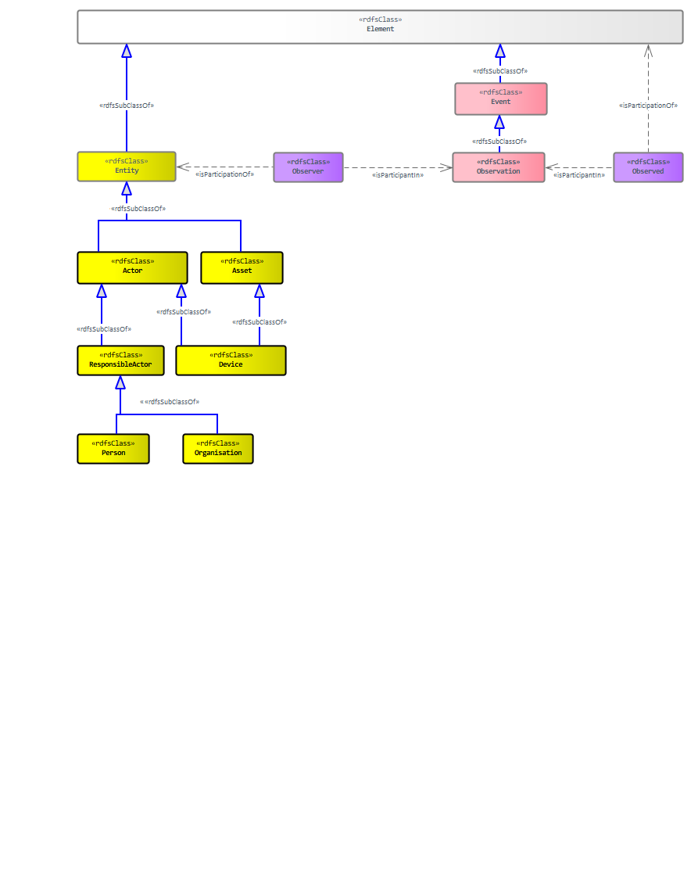
Extensions to IES for Tracks
<<rdfsClass>>
LocationObservation
<<rdfsClass>>
ObservedTarget
<<rdfsClass>>
ObservedLocation
Four new classes to cover the case of a target’s location.
The approach is to have the observed item (the vessel) and the observed location (the geo point) as participants in the observation activity, along with the observer (the AIS receiver, a device - LocationTransponder)
<<rdfsClass>>
LocationTransponder

Slide 4
RDF Schema for Track Extensions
@prefix ies: <http://ies.data.gov.uk/ontology/ies4#> .
@prefix rdf: <http://www.w3.org/1999/02/22-rdf-syntax-ns#> .
@prefix rdfs: <http://www.w3.org/2000/01/rdf-schema#> .
ies:LocationTransponder rdf:type rdfs:Class .
ies:LocationTransponder rdfs:subClassOf ies:CommunicationsDevice .
ies:LocationObservation rdf:type rdfs:Class .
ies:LocationObservation rdfs:subClassOf ies:Observation .
ies:ObservedLocation rdf:type rdfs:Class .
ies:ObservedLocation rdfs:subClassOf ies:Observed .
ies:ObservedTarget rdf:type rdfs:Class .
ies:ObservedTarget rdfs:subClassOf ies:Observed .

Slide 5
Example: Ship observed at location on 1st April at 1:57pm
space
data:2020-04-01T13:57
data:MMSI_367330510_Observed
data:MMSI_367330510
data:MyLatLongPointObserved
data:MyLatLongPoint
data:Observing_MMSI_367330510
data:MyObservation
data:TheObserver
time
Observer not known in the case of openly available AIS source data
D
ies:isParticipationOf
Or
data:TheObserver
data:Observing_MMSI_367330510
data:MMSI_367330510
LT
ies:isParticipationOf
OT
ies:isParticipantIn
LO
ies:inPeriod
PP
data:MMSI_367330510_Observed
ies:isParticipantIn
data:MyObservation
data:2020-04-01T13:57
data:MyLatLongPoint
GP
ies:isParticipationOf
OL
data:MyLatLongPointObserved
KEY:
D ies:Device
GP ies:GeoPoint
LO ies:LocationObservation
OL ies:ObservedLocation
OT ies:ObservedTarget
Or ies:Observer
PP ies:ParticularPeriod
LT ies:LocationTransponder (new addition to model)
Namespaces:
@prefix rdf: <http://www.w3.org/1999/02/22-rdf-syntax-ns#> .
@prefix rdfs: <http://www.w3.org/2000/01/rdf-schema#> .
@prefix ies: <http://ies.data.gov.uk/ies4#> .
@prefix data: <http://data.gov.uk/testdata#> .

Slide 6
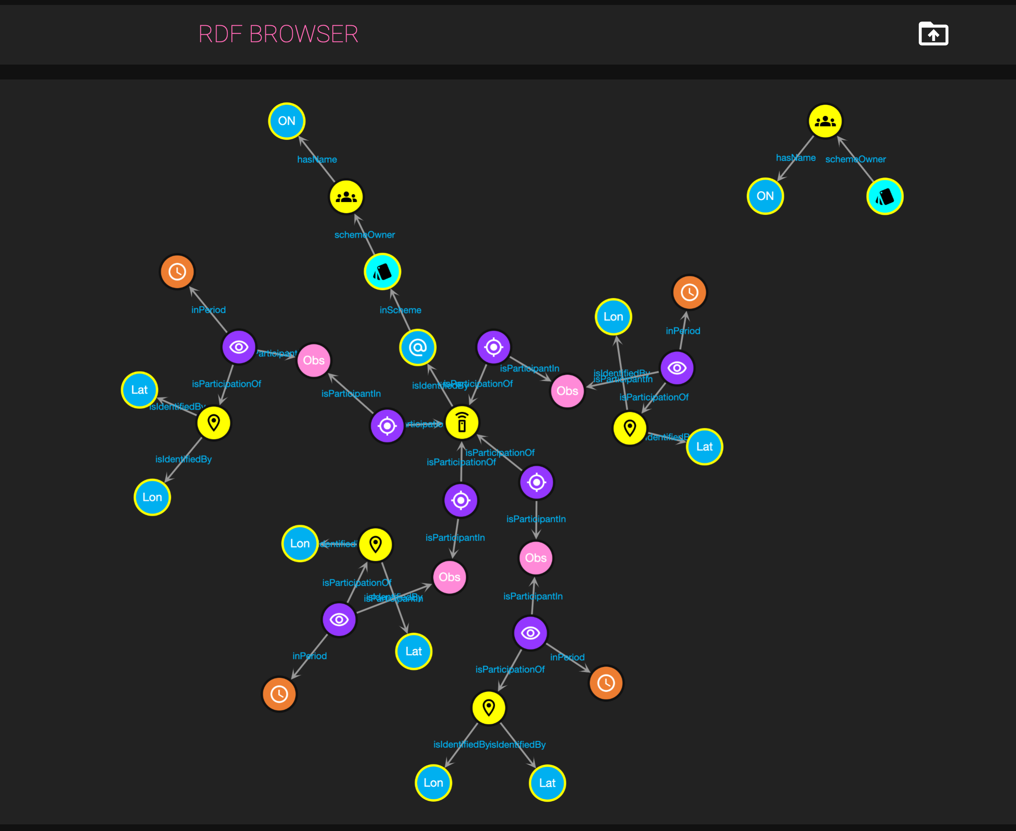
Example Track Data (in RDF Turtle)
@prefix data: <http://ais.data.gov.uk/ais-ies-test#> .
@prefix ies: <http://ies.data.gov.uk/ontology/ies4#> .
#Boilerplate stuff - setting the naming schemes used in the data, and the owners of those schemes. This could be put in a separate RDF file and referenced if need be
<http://imo.org> a ies:Organisation ;
ies:hasName data:96fbe176-74a3-4dd8-ac76-adefc4c3d3d1 .
data:96fbe176-74a3-4dd8-ac76-adefc4c3d3d1 a ies:OrganisationName ;
ies:representationValue "International Maritime Organisation" .
<http://imo.org#imo-NamingScheme> a ies:NamingScheme ;
ies:schemeOwner <http://imo.org> .
<http://itu.int> a ies:Organisation ;
ies:hasName data:23a814e7-4859-48d9-a91d-14218198bb70 .
data:23a814e7-4859-48d9-a91d-14218198bb70 a ies:OrganisationName ;
ies:representationValue "International Telecommunications Union" .
<http://itu.int#mmsi-NamingScheme> a ies:NamingScheme ;
ies:schemeOwner <http://itu.int> .
#The transponder - note, LocationTransponder was added as a new class to the IES ontology for the purposes of MIKES
data:MMSI_367330510 a ies:LocationTransponder ;
ies:isIdentifiedBy data:7f79de9e-1307-4a8a-969a-ff683864868a .
data:7f79de9e-1307-4a8a-969a-ff683864868a a ies:CommunicationsIdentifier ;
ies:inScheme <http://itu.int#mmsi-NamingScheme> ;
ies:representationValue "367330510" .
#The overarching track observation (each individual LocationObservation is part of this)
data: MMSI_367330510_track_observation_0000101 a ies:Observation .
#Now the observations - note this is just using simple lat and long points from IES. We have not tried to use the EPSG stuff yet as lat and long are already covered in the model.
#"timestamp": "2017-01-05T00:00:00", "coordinates": ["38.03654", "-122.12249"]
data:1d867d78-b763-495e-81d3-18ca7ff23d62 a ies:LocationObservation ;
ies:isPartOf data: MMSI_367330510_track_observation_0000101 .
data:cbf8c7bf-ee6f-4089-af6d-d4b7f5043f7a a ies:ObservedLocation ;
ies:inPeriod <http://iso.org/iso8601#2017-01-05T00%3A00%3A00> ;
ies:isParticipantIn data:1d867d78-b763-495e-81d3-18ca7ff23d62 ;
ies:isParticipationOf data:2953e2a9-5197-4508-87ad-7e96901a9dc3 .
<http://iso.org/iso8601#2017-01-05T00%3A00%3A00> a ies:ParticularPeriod ;
ies:iso8601PeriodRepresentation "2017-01-05T00:00:00" .
data:2953e2a9-5197-4508-87ad-7e96901a9dc3 a ies:GeoPoint ;
ies:isIdentifiedBy data:170a29fb-ba21-4d8a-9dbe-5ece6ee8b741,
data:5f48dd15-c79e-4bd6-8857-4e5d38fa9a34 .
data:5f48dd15-c79e-4bd6-8857-4e5d38fa9a34 a ies:Longitude ;
ies:representationValue "-122.12249" .
data:170a29fb-ba21-4d8a-9dbe-5ece6ee8b741 a ies:Latitude ;
ies:representationValue "38.03654" .
data:131f4043-067b-47ad-9ef6-7983dc0689de a ies:ObservedTarget ;
ies:isParticipantIn data:1d867d78-b763-495e-81d3-18ca7ff23d62 ;
ies:isParticipationOf data:MMSI_367330510 .
#"timestamp": "2017-01-05T00:01:08", "coordinates": ["38.03654", "-122.12250"]
data:cdbb5fa7-1d38-4722-a10c-05635d31ab23 a ies:Observation ;
ies:isPartOf data: MMSI_367330510_track_observation_0000101 .
data:6ea333b2-0818-45fc-934d-58767cbc5e2e a ies:ObservedLocation ;
ies:inPeriod <http://iso.org/iso8601#2017-01-05T00%3A01%3A08> ;
ies:isParticipantIn data:cdbb5fa7-1d38-4722-a10c-05635d31ab23 ;
ies:isParticipationOf data:dab518fd-46b0-4064-8039-c407637b6b0d .
<http://iso.org/iso8601#2017-01-05T00%3A01%3A08> a ies:ParticularPeriod ;
ies:iso8601PeriodRepresentation "2017-01-05T00:01:08" .
data:dab518fd-46b0-4064-8039-c407637b6b0d a ies:GeoPoint ;
ies:isIdentifiedBy data:53a426bb-04da-421b-8934-3b562dec25a7,
data:f32165d4-e134-402c-8646-4f684dbf70b8 .
data:53a426bb-04da-421b-8934-3b562dec25a7 a ies:Longitude ;
ies:representationValue "-122.12250" .
data:f32165d4-e134-402c-8646-4f684dbf70b8 a ies:Latitude ;
ies:representationValue "38.03654" .
data:5d6457cb-df4d-4def-a3f2-9529efe0e982 a ies:ObservedTarget ;
ies:isParticipantIn data:cdbb5fa7-1d38-4722-a10c-05635d31ab23 ;
ies:isParticipationOf data:MMSI_367330510 .
#"timestamp": "2017-01-05T00:02:09", "coordinates": ["38.03650", "-122.12249"]
data:0dcce9d6-8a80-48c1-a732-e7214da94c36 a ies:Observation ;
ies:isPartOf data: MMSI_367330510_track_observation_0000101 .
data:e93120b6-42cf-4794-8479-dee9ec54a87f a ies:ObservedLocation ;
ies:inPeriod <http://iso.org/iso8601#2017-01-05T00%3A02%3A09> ;
ies:isParticipantIn data:0dcce9d6-8a80-48c1-a732-e7214da94c36 ;
ies:isParticipationOf data:20514b92-dcbd-4e29-babb-fb5f4f61ec96 .
<http://iso.org/iso8601#2017-01-05T00%3A02%3A09> a ies:ParticularPeriod ;
ies:iso8601PeriodRepresentation "2017-01-05T00:02:09" .
data:20514b92-dcbd-4e29-babb-fb5f4f61ec96 a ies:GeoPoint ;
ies:isIdentifiedBy data:997fc3ab-33e4-42cd-ac8b-ccd4d297ffe8,
data:9f5de12e-8a09-449e-b111-88d818a3a66c .
data:9f5de12e-8a09-449e-b111-88d818a3a66c a ies:Longitude ;
ies:representationValue "-122.12249" .
data:997fc3ab-33e4-42cd-ac8b-ccd4d297ffe8 a ies:Latitude ;
ies:representationValue "38.03650" .
data:58bda6fb-a23f-4eb1-be36-519f062b5817 a ies:ObservedTarget ;
ies:isParticipantIn data:0dcce9d6-8a80-48c1-a732-e7214da94c36 ;
ies:isParticipationOf data:MMSI_367330510 .
#"timestamp": "2017-01-05T00:03:10", "coordinates": ["38.03653", "-122.12245"]
data:14848579-9801-4c4d-b697-15a613519521 a ies:Observation ;
ies:isPartOf data: MMSI_367330510_track_observation_0000101 .
data:9878c574-cf82-4180-adcd-6776ddea8450 a ies:ObservedLocation ;
ies:inPeriod <http://iso.org/iso8601#2017-01-05T00%3A03%3A10> ;
ies:isParticipantIn data:14848579-9801-4c4d-b697-15a613519521 ;
ies:isParticipationOf data:5d98f40c-9360-4532-9dbf-1f8b3e5eec95 .
<http://iso.org/iso8601#2017-01-05T00%3A03%3A10> a ies:ParticularPeriod ;
ies:iso8601PeriodRepresentation "2017-01-05T00:03:10" .
data:5d98f40c-9360-4532-9dbf-1f8b3e5eec95 a ies:GeoPoint ;
ies:isIdentifiedBy data:88113296-79eb-4888-9622-a3513d5da541,
data:983aba81-d6fb-4cfb-bc80-ccde5c828265 .
data:983aba81-d6fb-4cfb-bc80-ccde5c828265 a ies:Longitude ;
ies:representationValue "-122.12245" .
data:88113296-79eb-4888-9622-a3513d5da541 a ies:Latitude ;
ies:representationValue "38.03653" .
data:8c674432-1711-4b68-9955-fe6b27ab3d70 a ies:ObservedTarget ;
ies:isParticipantIn data:14848579-9801-4c4d-b697-15a613519521 ;
ies:isParticipationOf data:MMSI_367330510 .

Slide 7
Observation of measures / characteristics
DRAFT – Not Approved by Dstl Yet
<<objectPropery>>
observedCharacteristic
<<rdfsClass>>
Characteristic
<<rdfsRange>>
<<rdfsClass>>
Measurement
<<rdfsClass>>
Measure
All this does is add a Measurement event class and an observedCharacteristic predicate to link a characteristic or Measure to an Observed state

Slide 8
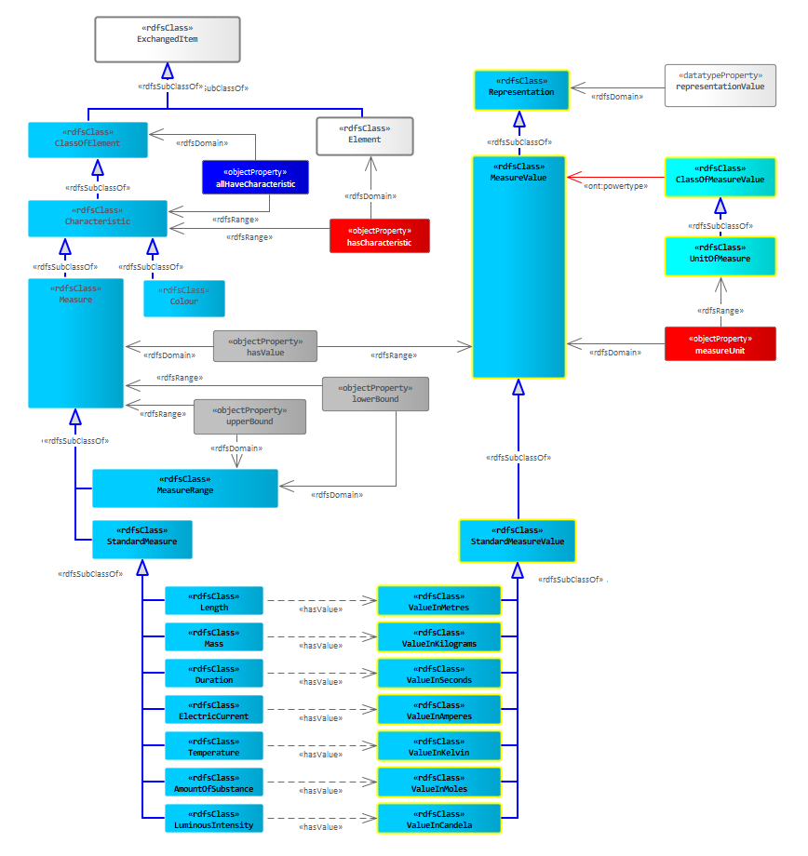
Course over Ground, Speed over Ground
DRAFT – Not Approved by Dstl Yet
<<rdfsClass>>
ClassOfMeasure
Addition of ClassOfMeasure powertype allows for new measures to be added without having to use subtype in your data. In the case of course and speed, there is no need to add them to the model (unless someone decides they need to be standard measures). Example would be:
<<powertype>>
<degreesNorth> rdf:type ies:UnitOfMeasure .
<course> rdf:type ies:ClassOfMeasure .
<x> rdf:type ies:LocationTransponder .
<xObserved> rdf:type ies:ObservedTarget .
<xObserved> ies:isParticipationOf <x> .
<xObserved> ies:isParticipationIn <xObservation>
<xObserved> ies:observedCharacteristic <y> .
<y> rdf:type <course> .
<y> ies:hasValue <yVal> .
<yVal> rdf:type ies:MeasureValue .
<yVal> ies:representationValue “90” .
<yVal> ies:measureUnit <degNorth>.
<<rdfsRange>>
<<rdfsDomain>>
<<objectProperty>>
measureClass
“90”
LT
OT
<yVal>
MV
<x>
ies:isParticipationOf
UoM
ies:isParticipantIn
<xObserved>
<DegreesNorth>
ies:observedCharacteristic
ies:hasValue
LO
Me
CoM
<xObservation>
<y>
<Course>

Slide 9
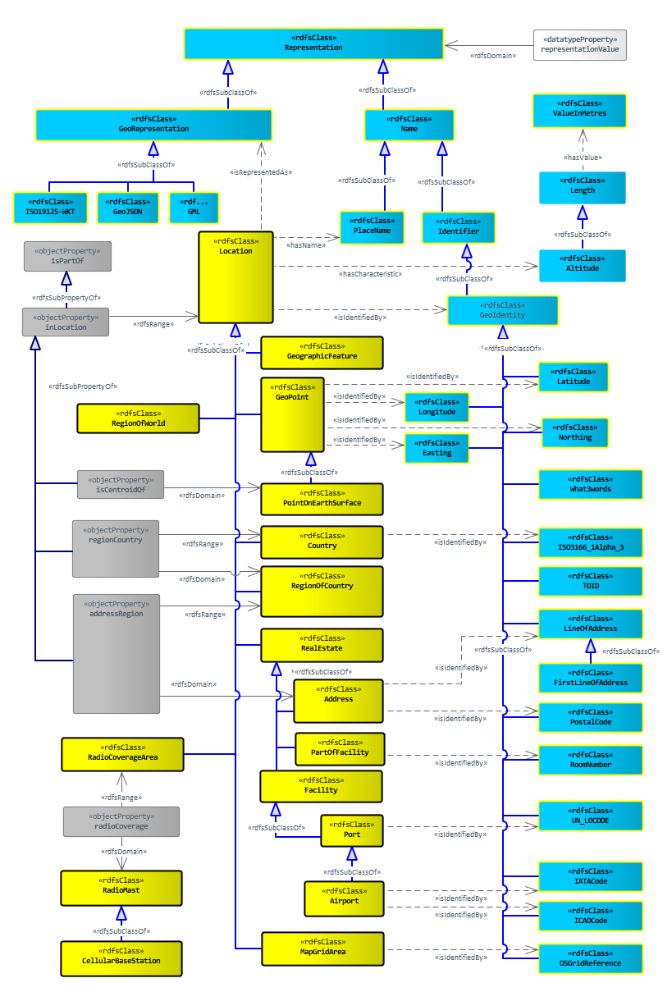
Alternate Coordinate Systems – using EPSG codes
DRAFT – Not Approved by Dstl Yet
Some of the track analytics apps use varying coordinate systems. EPSG has categorised a huge number of these coordinate systems and mapped them onto between 2 and 4 parameters, so we are proposing to capture this in IES.
@prefix ies: <http://ies.data.gov.uk/ontology/ies4#> .
@prefix rdf: <http://www.w3.org/1999/02/22-rdf-syntax-ns#> .
@prefix rdfs: <http://www.w3.org/2000/01/rdf-schema#> .
ies:EpsgGeoPointRepresentation rdf:type rdfs:Class .
ies:LocationTransponder rdfs:subClassOf ies:GeoIdentity .
ies:epsgCode rdf:type owl:datatypeProperty .
ies:epsgCode rdfs:subPropertyOf ies:attribute .
ies:epsgCode rdfs:domain ies:EpsgGeoPointRepresentation .
ies:EpsgParameter1 rdf:type rdfs:Class .
ies:EpsgParameter1 rdfs:subClassOf ies:Representation .
ies:EpsgParameter2 rdf:type rdfs:Class .
ies:EpsgParameter2 rdfs:subClassOf ies:Representation .
ies:EpsgParameter3 rdf:type rdfs:Class .
ies:EpsgParameter3 rdfs:subClassOf ies:Representation .
ies:EpsgParameter4 rdf:type rdfs:Class .
ies:EpsgParameter4 rdfs:subClassOf ies:Representation .
<<isIdentifiedBy>>
<<rdfsClass>>
EpsgGeoPoint
Representation
<<rdfsClass>>
EpsgParameter1
<<inRepresentation>>
<<rdfsClass>>
EpsgParameter2
<<inRepresentation>>
<<rdfsClass>>
EpsgParameter3
<<inRepresentation>>
<<rdfsClass>>
EpsgParameter4
<<inRepresentation>>
<<datatypeProperty>>
epsgCode

Slide 10
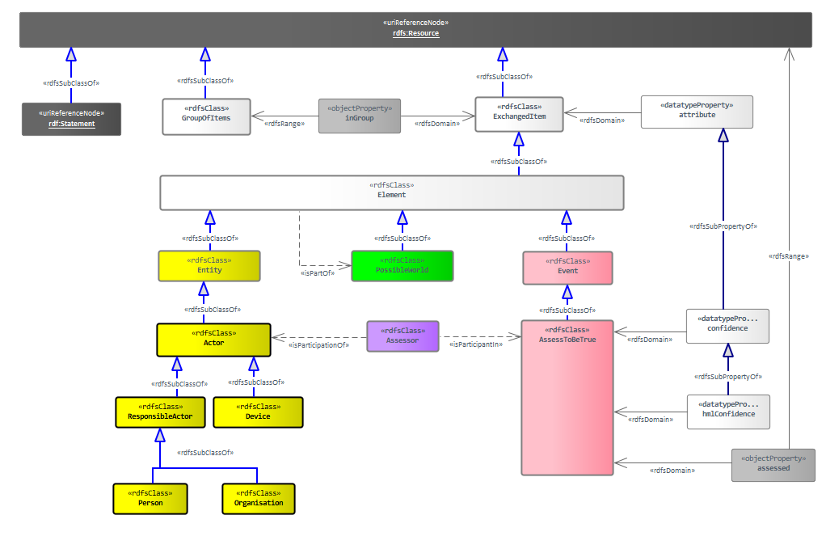
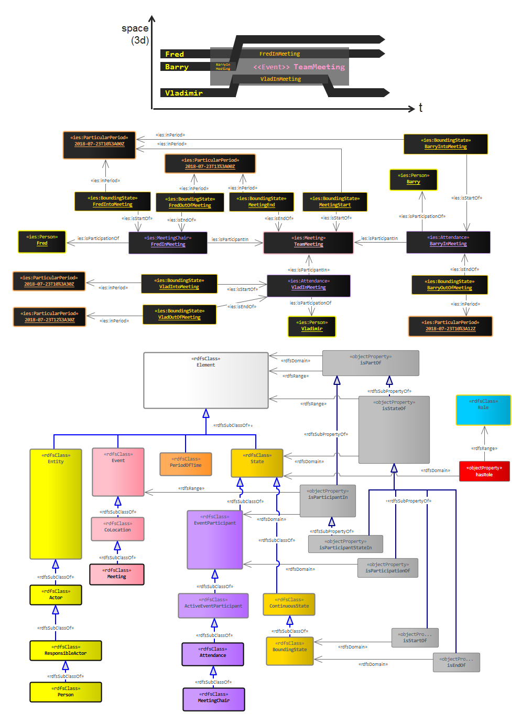
Extensions to IES for “following”
In this approach, we simply use what’s already in IES, with the only required extensions are to create a Following event, and the necessary EventParticipant roles for the follower and the followed.
<<rdfsClass>>
Follow
The possible worlds model does not need to change, and we can use it in the usual IES fashion with AssessToBeTrue. The Assessor could then be a System (e.g. Odysseus, Wisdom)
The confidence could be expressed using the UK Govt PHIA Probability Yardstick - https://www.app.college.police.uk/app-content/intelligence-management/analysis/delivering-effective-analysis/
Probably also need to add AssessToBeFalse (again with the same confidence criteria).
<<rdfsClass>>
Followed
Here we have two types of follower participant – those who are just following (we don’t know if they’re actively choosing to follow) and active follower.
<<rdfsClass>>
Follower
<<rdfsClass>>
ActiveFollower

Slide 11
Option One Example – A following B
LT
ies:isParticipationOf
Fd
data:MMSI_367330510
ies:isParticipantIn
F
PW
ies:assessed
AT
As
ies:isParticipationOf
S
ies:isPartOf
ies:isParticipantIn
ies:isParticipantIn
e.g.
Odysseus, Wisdom
ies:inPeriod
ies:inPeriod
LT
ies:isParticipationOf
Fr
PP
PP
data:MMSI_239750961
data:2020-04-01T13:57
data:2020-04-01T18:00
Note time of following event and time of assessment may be different
KEY:
As ies:Assessor
AT ies:AssessToBeTrue
F ies:Follow
Fd ies:Followed
Fr ies:Follower
LT ies:LocationTransponder
PP ies:ParticularPeriod
PW ies:PossibleWorld
S ies:System
Namespaces:
@prefix rdf: <http://www.w3.org/1999/02/22-rdf-syntax-ns#> .
@prefix rdfs: <http://www.w3.org/2000/01/rdf-schema#> .
@prefix ies: <http://ies.data.gov.uk/ies4#> .
@prefix data: <http://data.gov.uk/testdata#> .

Slide 12
RDF Schema for “Following” Use-Case Extensions
@prefix ies: <http://ies.data.gov.uk/ontology/ies4#> .
@prefix rdf: <http://www.w3.org/1999/02/22-rdf-syntax-ns#> .
@prefix rdfs: <http://www.w3.org/2000/01/rdf-schema#> .
ies:Follow rdf:type rdfs:Class .
ies:Follow rdfs:subClassOf ies:Event .
ies:Followed rdf:type rdfs:Class .
ies:Followed rdfs:subClassOf ies:EventParticipant .
ies:Follower rdf:type rdfs:Class .
ies:Follower rdfs:subClassOf ies:EventParticipant .
ies:ActiveFollower rdf:type rdfs:Class .
ies:ActiveFollower rdfs:subClassOf ies:Follower .
ies:ActiveFollower rdfs:subClassOf ies:ActiveEventParticipant .

Slide 13
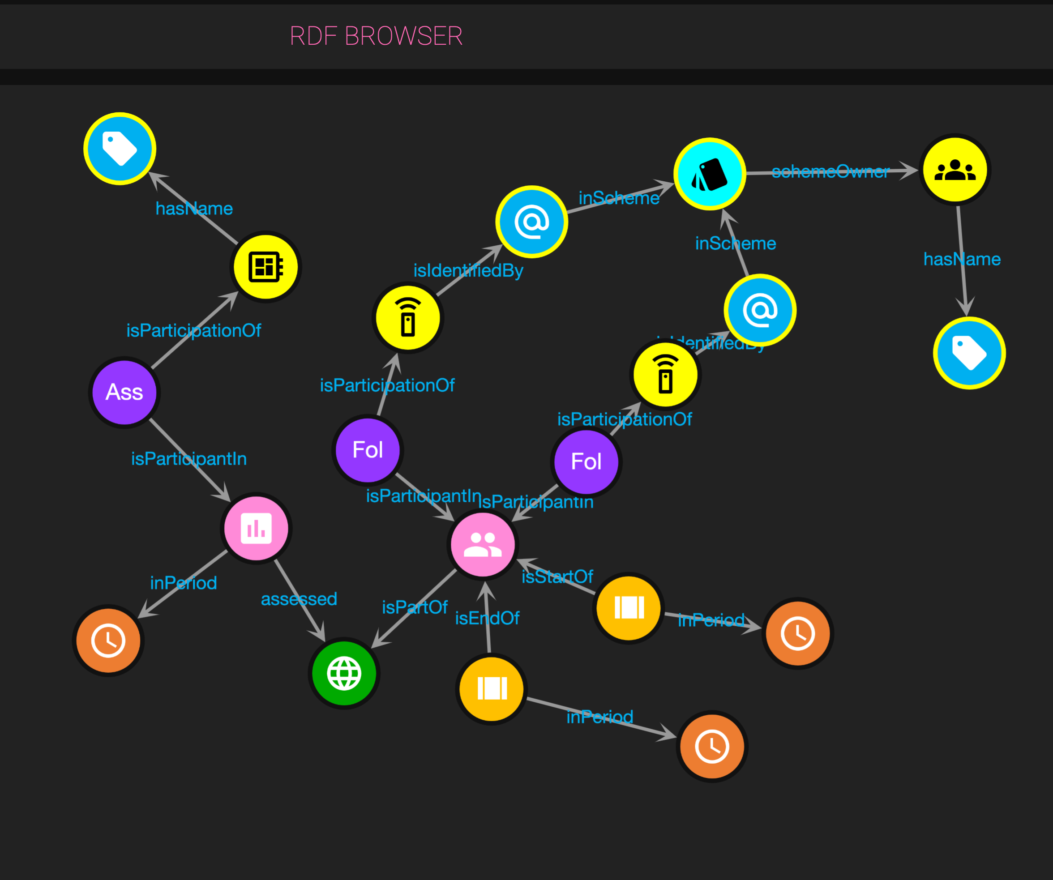
Example “Following” Data:
@prefix data: <http://ais.data.gov.uk/ais-ies-test#> .
@prefix ies: <http://ies.data.gov.uk/ontology/ies4#> .
@prefix iso8601: <http://iso.org/iso8601#> .
@prefix xsd: <http://www.w3.org/2001/XMLSchema#> .
data:0edbd5f1-1c3b-4e59-b296-b4781313edff a ies:Assessor ;
ies:isParticipantIn data:528acb27-8877-4965-995d-ba6f72f3363a ;
ies:isParticipationOf data:a4da7459-b746-4a85-aedf-27fc21649013 .
data:196be3f6-8dd6-4d31-8807-9802714f94f3 a ies:BoundingState ;
ies:inPeriod iso8601:2007-01-01T00:00:09 ;
ies:isStartOf data:f89a179d-29e6-44aa-b3db-65921a98d30e .
data:d9e26359-258d-46d3-9383-4e3ae959160a a ies:Follower ;
ies:isParticipantIn data:f89a179d-29e6-44aa-b3db-65921a98d30e ;
ies:isParticipationOf data:MMSI_367000150 .
data:da95c036-d980-4b98-934f-16373d38eabe a ies:BoundingState ;
ies:inPeriod iso8601:2007-01-01T00:05:40 ;
ies:isEndOf data:f89a179d-29e6-44aa-b3db-65921a98d30e .
data:dac815eb-06a7-45c7-a208-e38fbfe3d5c7 a ies:Followed ;
ies:isParticipantIn data:f89a179d-29e6-44aa-b3db-65921a98d30e ;
ies:isParticipationOf data:MMSI_366952890 .
data:05560c92-c9fb-4c6d-a342-d8ff127f41ea a ies:Name ;
ies:representationValue "HAL"^^xsd:string .
data:528acb27-8877-4965-995d-ba6f72f3363a a ies:Assess ;
ies:assessed data:3c23fd87-227b-41bf-8211-e12bc8d4f492 .
data:7989b8b8-0847-4799-88fd-d5ba50b08cc6 a ies:Name ;
ies:representationValue "International Telecommunications Union"^^xsd:string .
data:MMSI_366952890 a ies:LocationTransponder ;
ies:isIdentifiedBy data:MMSI_366952890_idObj .
data:MMSI_366952890_idObj a ies:CommunicationsIdentifier ;
ies:inScheme <http://itu.int#mmsi-NamingScheme> ;
ies:representationValue "366952890"^^xsd:string .
data:MMSI_367000150 a ies:LocationTransponder ;
ies:isIdentifiedBy data:MMSI_367000150_idObj .
data:MMSI_367000150_idObj a ies:CommunicationsIdentifier ;
ies:inScheme <http://itu.int#mmsi-NamingScheme> ;
ies:representationValue "367000150"^^xsd:string .
data:a4da7459-b746-4a85-aedf-27fc21649013 a ies:System ;
ies:hasName data:05560c92-c9fb-4c6d-a342-d8ff127f41ea .
iso8601:2007-01-01T00:00:09 a ies:ParticularPeriod .
iso8601:2007-01-01T00:05:40 a ies:ParticularPeriod .
<http://itu.int> a ies:Organisation ;
ies:hasName data:7989b8b8-0847-4799-88fd-d5ba50b08cc6 .
data:3c23fd87-227b-41bf-8211-e12bc8d4f492 a ies:PossibleWorld .
<http://itu.int#mmsi-NamingScheme> a ies:NamingScheme ;
ies:schemeOwner <http://itu.int> .
data:f89a179d-29e6-44aa-b3db-65921a98d30e a ies:Follow ;
ies:isPartOf data:3c23fd87-227b-41bf-8211-e12bc8d4f492 .

Slide 14
Extensions to IES for “coopering”
“Coopering at sea” is when more than one vessel operate together as a team.
As with the ”following” pattern, the Govt PHIA Probability Yardstick can be used in conjuction with the possible worlds model.
<<rdfsClass>>
CooperAtSea
<<rdfsClass>>
CooperingAtSea

Slide 15
RDF Schema for “Coopering” Use-Case Extensions
@prefix ies: <http://ies.data.gov.uk/ontology/ies4#> .
@prefix rdf: <http://www.w3.org/1999/02/22-rdf-syntax-ns#> .
@prefix rdfs: <http://www.w3.org/2000/01/rdf-schema#> .
ies:CooperAtSea rdf:type rdfs:Class .
ies:CooperAtSea rdfs:subClassOf ies:Event .
ies:CooperingAtSea rdf:type rdfs:Class .
ies:CooperingAtSea rdfs:subClassOf ies:EventParticipant .
V
ies:isParticipationOf
Ca
ies:isPartOf
data:MMSI_367330510
ies:isParticipantIn
C
PW
ies:assessed
AT
As
ies:isParticipationOf
S
ies:isPartOf
ies:isParticipantIn
ies:isParticipantIn
ies:inPeriod
ies:inPeriod
V
ies:isParticipationOf
Ca
PP
PP
data:MMSI_239750961
KEY:
As ies:Assessor
AT ies:AssessToBeTrue
C ies:CooperAtSea
Ca ies:CooperingAtSea
PP ies:ParticularPeriod
PW ies:PossibleWorld
S ies:System
V ies:Vessel
data:2020-04-01T13:57
data:2020-04-01T18:00
ies:isPartOf
Namespaces:
@prefix rdf: <http://www.w3.org/1999/02/22-rdf-syntax-ns#> .
@prefix rdfs: <http://www.w3.org/2000/01/rdf-schema#> .
@prefix ies: <http://ies.data.gov.uk/ies4#> .
@prefix data: <http://data.gov.uk/testdata#> .

Slide 16
Extensions to IES for “predicted destination”
The Dstl Track Analytics software can produce predictions of which destination port a vessel is heading to. Each prediction consists of a number of destinations, each with its own probability measure. IES has the concept of Sailing which is a type of Movement. Movement instances can have Departure and Arrival states. All that is required in this care are Vessel (added for MIKES), Arrival, VehicleUsed and Sailing. So no additions required beyond Vessel. To cover the probabilities, the Arrival instances will be parts of possible worlds.
<<rdfsClass>>
Assess
<<rdfsClass>>
AssessProbability
<<rdfsClass>>
AssessToBeTrue
<<hasRepresentation>>
<<rdfsClass>>
ProbabilityRepresentation
The Track Analytics software provides a 0.0->1.0 probability for each destination. Therefore, the model may need to be extended with the appropriate Assess subtype and representation.

Slide 17
RDF Schema for “Predicted Destination” Use-Case Extensions
P
ies:inLocation
V
ies:isParticipationOf
VU
ies:isParticipantIn
Sa
Ar
PR
ies:isEndOf
ies:isPartOf
ies:isPartOf
ies:hasRepresentation
ies:isPartOf
PW
AP
As
S
ies:assessed
ies:isParticipantIn
ies:isParticipationOf
KEY:
AP ies:AssessProbability
Ar ies:Arrival
As ies:Assessor
P ies:Port
PR ies:ProbabilityRepresentation
PW ies:PossibleWorld
S ies:System
Sa ies:Sailing
V ies:Vessel
VU ies:VehicleUsed
Namespaces:
@prefix rdf: <http://www.w3.org/1999/02/22-rdf-syntax-ns#> .
@prefix rdfs: <http://www.w3.org/2000/01/rdf-schema#> .
@prefix ies: <http://ies.data.gov.uk/ies4#> .
@prefix data: <http://data.gov.uk/testdata#> .

Slide 18
Extensions to IES for “approaching”
This extension follows exactly the same pattern as the “following” use-case. It even includes the idea of deliberate / active approaching
<<rdfsClass>>
Approach
<<rdfsClass>>
Approached
<<rdfsClass>>
Approacher
<<rdfsClass>>
ActiveApproacher

Slide 19
RDF Schema for “Approaching” Use-Case Extensions
@prefix ies: <http://ies.data.gov.uk/ontology/ies4#> .
@prefix rdf: <http://www.w3.org/1999/02/22-rdf-syntax-ns#> .
@prefix rdfs: <http://www.w3.org/2000/01/rdf-schema#> .
ies:Approach rdf:type rdfs:Class .
ies:Approach rdfs:subClassOf ies:Event .
ies:Approached rdf:type rdfs:Class .
ies:Approached rdfs:subClassOf ies:EventParticipant .
ies:Approacher rdf:type rdfs:Class .
ies:Approacher rdfs:subClassOf ies:EventParticipant .
ies:ActiveApproacher rdf:type rdfs:Class .
ies:ActiveApproacher rdfs:subClassOf ies:Approacher .
ies:ActiveApproacher rdfs:subClassOf ies:ActiveEventParticipant .

Slide 20
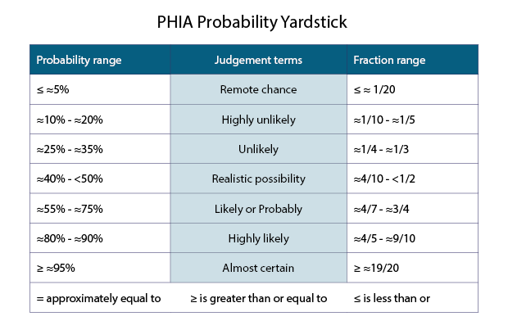
Proposed IES Modifications for Assessments
<<rdfsClass>>
Event
ies:powertype
<<rdfsClass>>
ClassOfEvent
<<rdfsClass>>
Assess
<<rdfsClass>>
PhiaAssessmentYardstick
<<rdfsClass>>
AssessToBeTrue
new stuff
rdf:type
rdfs:subClassOf
<<rdfsClass>>
AssessProbability
<<rdfsClass>>
ProbabilityRepresentation
<<hasRepresentation>>
<<rdfsClass>>
AssessToBeRemoteChance
<<rdfsClass>>
AssessToBeHighlyUnlikely
See: https://www.app.college.police.uk/app-content/intelligence-management/analysis/delivering-effective-analysis/
<<rdfsClass>>
AssessToBeUnlikely
<<rdfsClass>>
AssessToBeRealisticPossibility
<<rdfsClass>>
AssessToBeLikelyOrProbably
<<rdfsClass>>
AssessToBeHighlyLikely
<<rdfsClass>>
AssessToBeAlmostCertain

Slide 21
RDF Schema for Assessment Extensions
@prefix ies: <http://ies.data.gov.uk/ontology/ies4#> .
@prefix rdf: <http://www.w3.org/1999/02/22-rdf-syntax-ns#> .
@prefix rdfs: <http://www.w3.org/2000/01/rdf-schema#> .
ies:Assess rdf:type rdfs:Class .
ies:Assess rdfs:subClassOf ies:Event .
ies:AssessToBeTrue rdfs:subClassOf ies:Assess .
ies:PhiaAssessmentYardstick rdf:type rdfs:Class .
ies:PhiaAssessmentYardstick rdfs:subClassOf ies:ClassOfEventEvent .
ies:AssessToBeRemoteChance rdf:type rdfs:Class .
ies:AssessToBeRemoteChance rdf:type ies:PhiaAssessmentYardstick .
ies:AssessToBeRemoteChance rdfs:subClassOf ies:Assess .
ies:AssessToBeHighlyUnlikely rdf:type rdfs:Class .
ies:AssessToBeHighlyUnlikely rdf:type ies:PhiaAssessmentYardstick .
ies:AssessToBeHighlyUnlikely rdfs:subClassOf ies:Assess .
ies:AssessToBeUnlikely rdf:type rdfs:Class .
ies:AssessToBeUnlikely rdf:type ies:PhiaAssessmentYardstick .
ies:AssessToBeUnlikely rdfs:subClassOf ies:Assess .
ies:AssessToBeRealisticPossibility rdf:type rdfs:Class .
ies:AssessToBeRealisticPossibility rdf:type ies:PhiaAssessmentYardstick .
ies:AssessToBeRealisticPossibility rdfs:subClassOf ies:Assess .
ies:AssessToBeLikelyOrProbably rdf:type rdfs:Class .
ies:AssessToBeLikelyOrProbably rdf:type ies:PhiaAssessmentYardstick .
ies:AssessToBeLikelyOrProbably rdfs:subClassOf ies:Assess .
ies:AssessToBeHighlyLikely rdf:type rdfs:Class .
ies:AssessToBeHighlyLikely rdf:type ies:PhiaAssessmentYardstick .
ies:AssessToBeHighlyLikely rdfs:subClassOf ies:Assess .
ies:AssessToBeAlmostCertain rdf:type rdfs:Class .
ies:AssessToBeAlmostCertain rdf:type ies:PhiaAssessmentYardstick .
ies:AssessToBeAlmostCertain rdfs:subClassOf ies:Assess .
This triple also needs to be removed from IES Schema:
ies:AssessToBeTrue rdfs:subClassOf ies:Event .
(Note: this is not a breaking change, as the class itself has not been removed)
(Note: the rdf:type rdfs:Class triples aren’t strictly needed given that ies:ClassOfEvent is a subclass of rdfs:Class, but not all ontology editors are smart enough to spot this.

Slide 22
ADSS -> IES Mapping
In the case of ADSS, we know we have a vessel (whereas with AIS all we know is that we have a LocationTransponder). ADSS fields we’re working with are:
detid, timestamp, geolocationX, geolocationY, chipURL
“1352445” "2015-11-02T11:52:25” "153.19219482305” "-27.721276080022” "/v2/car_detect/detections/1352445/chips/chip-image"]
The detid is a unique identifier for the observation, and this data follows a very similar pattern to the AIS observations pattern, except with a vessel…
"-27.721276080022”
ies:representationValue
data:ADSS1352445
Lat
OT/VS
ies:isParticipantIn
LO
ies:inPeriod
PP
ies:isIdentifiedBy
data:ADSS1352445_Observed
ies:isParticipantIn
ies:isIdentifiedBy
data:2015-11-02T11:52:25
Lon
ies:isIdentifiedBy
GP
ies:isParticipationOf
OL
data:ADSS1352445_ID
KEY:
D ies:Device
GP ies:GeoPoint
Id ies:Identifier
Lat ies:Latitude
Lon ies:Longitude
LO ies:LocationObservation
N ies:Name
NS ies:NamingScheme
OL ies:ObservedLocation
Or ies:Organisation
OT ies:ObservedTarget
PP ies:ParticularPeriod
VS ies:VesselState (addition to IES)
ies:representationValue
data:MyLatLongPoint
data:MyLatLongPointObserved
Id
"153.19219482305”
ies:representationValue
ies:inScheme
”1352445”
Namespaces:
@prefix rdf: <http://www.w3.org/1999/02/22-rdf-syntax-ns#> .
@prefix rdfs: <http://www.w3.org/2000/01/rdf-schema#> .
@prefix ies: <http://ies.data.gov.uk/ies4#> .
@prefix data: <http://data.gov.uk/testdata#> .
NS
data:ADSS_DETID
ies:hasName
ies:schemeOwner
ies:representationValue
N
Or
”ADSS Detection ID”
data:ADSSNSName
data:AUSDoD

Slide 23
ADSS -> IES Mapping – step by step (when)
The LocationObservation is linked to the timestamp by putting it “inPeriod” to a ParticularPeriod
data:ADSS1352445
LO
ies:inPeriod
PP
data:2015-11-02T11:52:25
KEY:
LO ies:LocationObservation
PP ies:ParticularPeriod
Namespaces:
@prefix rdf: <http://www.w3.org/1999/02/22-rdf-syntax-ns#> .
@prefix rdfs: <http://www.w3.org/2000/01/rdf-schema#> .
@prefix ies: <http://ies.data.gov.uk/ies4#> .
@prefix data: <http://data.gov.uk/testdata#> .

Slide 24
ADSS -> IES Mapping
– step by step (DETID)
data:ADSS1352445
The main object here is the LocationObservation event. It is this event that has the ADSS detection ID. The value of the ID is given by the ies:representationValue property.
We then use a NamingScheme (data:ADSS_DETID) to categorise the identifier. The NamingScheme itself has a name (for user readability purposes) and optionally an owner organisation.
LO
ies:isIdentifiedBy
data:ADSS1352445_ID
Id
ies:representationValue
ies:inScheme
”1352445”
NS
data:ADSS_DETID
The same NamingScheme would be referenced in every translated ADSS message – i.e. if required, the additional info about the NamingScheme could be kept in a centrally agreed ontology
ies:hasName
ies:schemeOwner
ies:representationValue
N
Or
”ADSS Detection ID”
data:ADSSNSName
data:AUSDoD
Namespaces:
@prefix rdf: <http://www.w3.org/1999/02/22-rdf-syntax-ns#> .
@prefix rdfs: <http://www.w3.org/2000/01/rdf-schema#> .
@prefix ies: <http://ies.data.gov.uk/ies4#> .
@prefix data: <http://data.gov.uk/testdata#> .
KEY:
Id ies:Identifier
LO ies:LocationObservation
N ies:Name
NS ies:NamingScheme
Or ies:Organisation

Slide 25
ADSS -> IES Mapping – step by step (where)
Just as with AIS, the observation observes to ObservedTarget and an ObservedLocation. In the case of ADSS though, we know we have a vessel (this isn’t always the case with AIS) so we should also make our data:ADSS1352445_Observed an instance of VesselState.
The Latitude and Longitude are then handled the same way as previous examples.
"-27.721276080022”
ies:representationValue
data:ADSS1352445
Lat
OT/VS
ies:isParticipantIn
LO
ies:isIdentifiedBy
data:ADSS1352445_Observed
ies:isParticipantIn
Lon
ies:isIdentifiedBy
GP
ies:isParticipationOf
OL
ies:representationValue
data:MyLatLongPoint
data:MyLatLongPointObserved
"153.19219482305”
Namespaces:
@prefix rdf: <http://www.w3.org/1999/02/22-rdf-syntax-ns#> .
@prefix rdfs: <http://www.w3.org/2000/01/rdf-schema#> .
@prefix ies: <http://ies.data.gov.uk/ies4#> .
@prefix data: <http://data.gov.uk/testdata#> .
KEY:
GP ies:GeoPoint
Lat ies:Latitude
Lon ies:Longitude
LO ies:LocationObservation
OL ies:ObservedLocation
OT ies:ObservedTarget
VS ies:VesselState

Slide 26
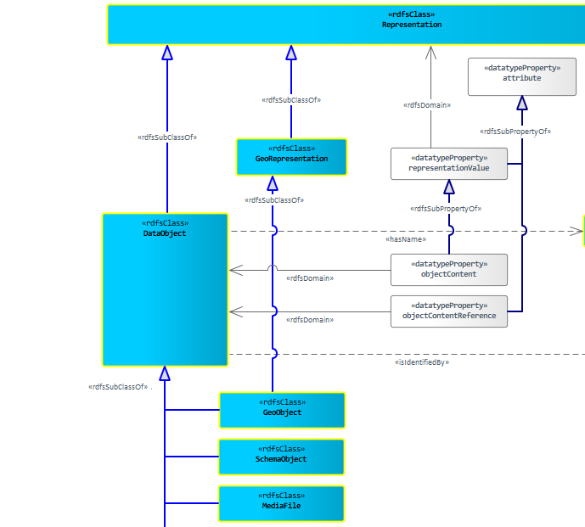
ADSS -> IES Mapping – extend model for image
IES is sometimes missing really obvious classes – this is an effect of the rule that “someone has to ask for it” for it to be in the model. No-one had asked for images…until now. So, the model would be:
IF
ies:isRepresentedAs
OT/VS
uriOfTheImage
data:ADSS1352445_Observed
In the ADSS case we just add the ImageFile and link it to the ObservedTarget. The URI of the image is the URI of the ImageFile instance.
<<rdfsClass>>
ImageFile

Slide 27
Exclusive Economic Zone
PW
ies:assessed
AT
ies:isParticipantIn
As
ies:isParticipationOf
S
ies:isPartOf
ies:inPeriod
PP
<<rdfsClass>>
VesselState
data:2020-04-01T18:00
<<rdfsClass>>
ExclusiveEconomicZone
<<rdfsClass>>
Vessel
EEZ
ies:inLocation
VS
ies:isStateOf
V
ies:isStartOf
ies:isEndOf
This is a fairly simple pattern. There is a state of the vessel when it is in the EEZ. That state has a begin and end (two bounding states). Finally, we put the state in a possible world as link it to the system that made the inference.
BS
BS
ies:inPeriod
ies:inPeriod
PP
PP
KEY:
As ies:Assessor
AT ies:AssessToBeTrue
BS ies:BoundingState
EEZ ies:ExclusiveEconomicZone
PP ies:ParticularPeriod
S ies:System
V ies:Vessel
VS ies:VesselState
data:2020-04-01T09:30
data:2020-04-01T14:22
Namespaces:
@prefix rdf: <http://www.w3.org/1999/02/22-rdf-syntax-ns#> .
@prefix rdfs: <http://www.w3.org/2000/01/rdf-schema#> .
@prefix ies: <http://ies.data.gov.uk/ies4#> .
@prefix data: <http://data.gov.uk/testdata#> .

Slide 28
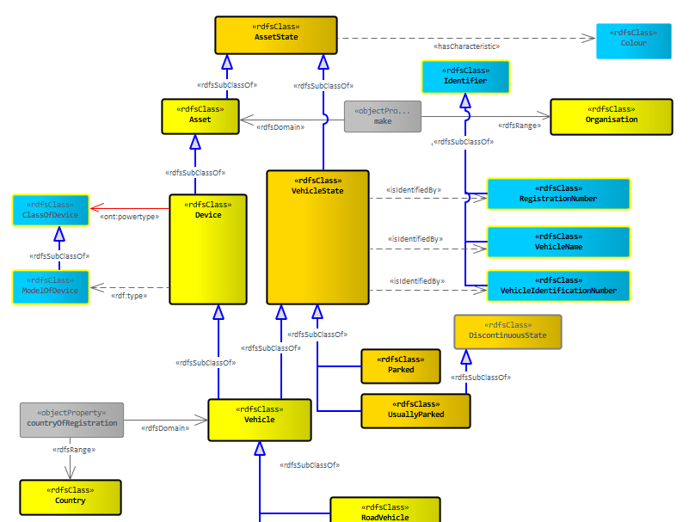
Flag of Convenience
As the IES model currently stands, countryOfRegistration links a Vehicle to a Country. This seems to be a mistake – it should link a VehicleState to a Country. It is then a simple case of modelling the registration of the vessel.
KEY:
C ies:Country
PW ies:PossibleWorld
UFC ies:UnderFlagOfConvenience
V ies:Vessel
VS ies:VesselState
V
ies:isStateOf
UFC
ies:isPartOf
PW
ies:countryOfRegistration
C
<<rdfsClass>>
VesselState
The flag of convenience aspect raises a question though – is this a blanket classification – e.g. all Panamanian registered ships are under a FoC ? These seems prone to problems as a tug operating only the Panama canal would be registered in Panama for reasons other than convenience. Hence we need a special type of state (UnderFlagOfConvenience) and a link to a possible world, as someone has assessed this to be true.
I’ve left off the details of begin / end states, and about the assessment, but it’s the same pattern as in previous examples.
<<rdfsClass>>
UnderFlagOfConvenience
Namespaces:
@prefix rdf: <http://www.w3.org/1999/02/22-rdf-syntax-ns#> .
@prefix rdfs: <http://www.w3.org/2000/01/rdf-schema#> .
@prefix ies: <http://ies.data.gov.uk/ies4#> .
@prefix data: <http://data.gov.uk/testdata#> .

